Slide 1


Future workshop: Rural regions in Europe

Slide 2
“The future we want must be invented. Otherwise we will get one we don't want.” – Joseph Beuys
Notes:
What does the saying mean to you? [Give time]
You have to think about what lies ahead and you should play a part in shaping the future.
Cf. Brexit, low voter turnout among young people
Young people tend to be more against Brexit
However, few young people voted in the Brexit referendum

Slide 3
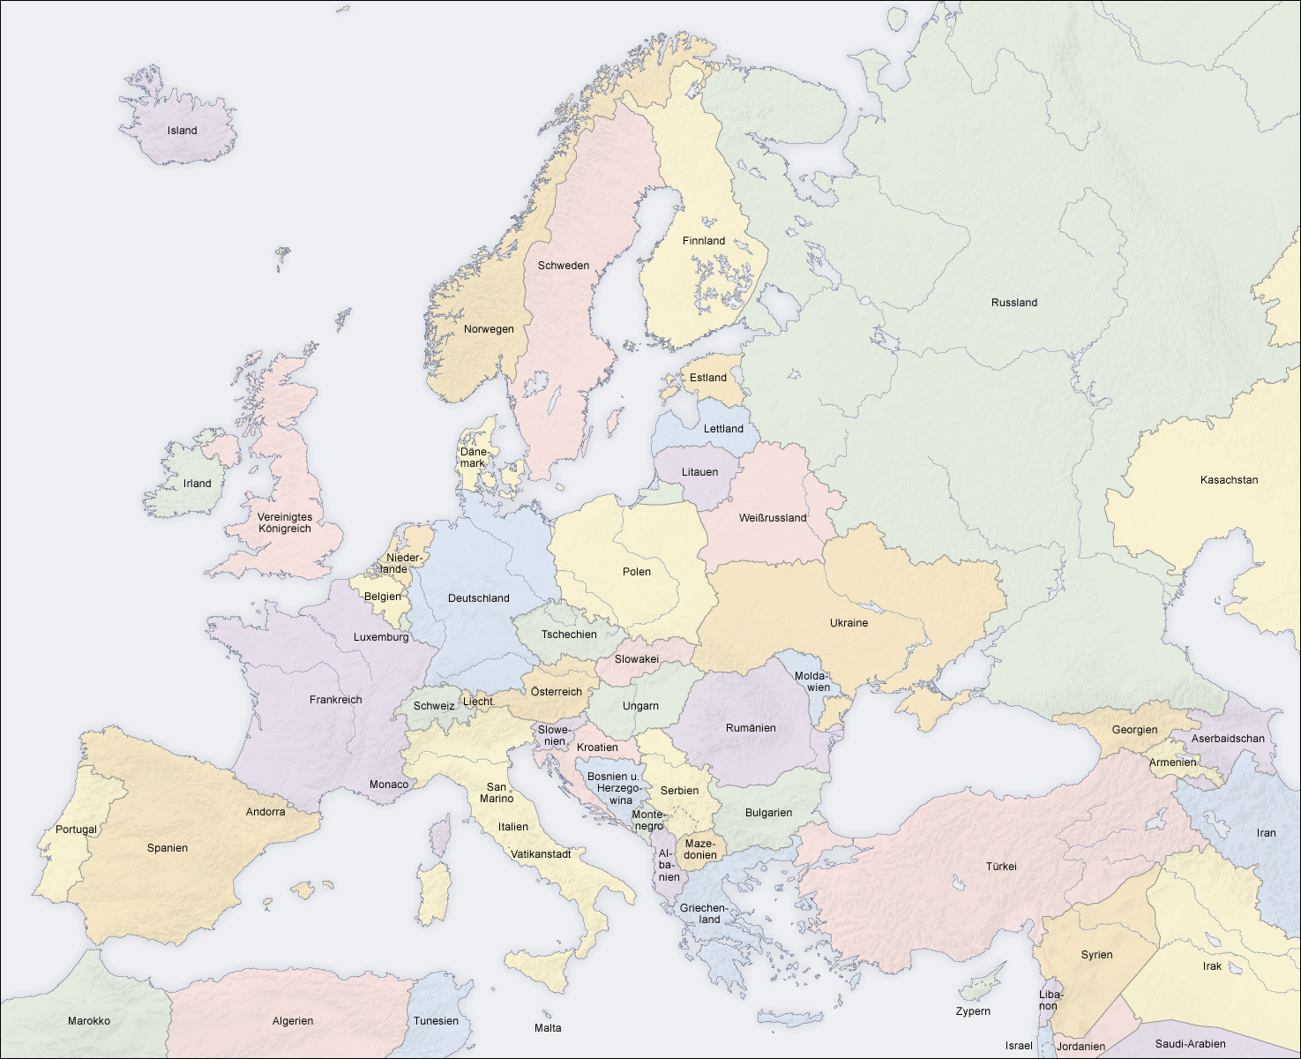
Regions of the future workshop
Podlasie
Lusatia
Murau
Severozapades
Extremadura
Campania

Slide 4
Procedure of the future workshop
Step 1: Critique: Read your factsheet and work out the problems and challenges of your region, analyze the graphics!
Step 2: Imagination: Look for creative solutions without constraints!
Step 3: Reality
Step 4: Presentation

Slide 5
Rules of the future workshop
Writing rules
Avoid key words, form half sentences
Document all thoughts
The posters do not have to look nice
Discussion rule
Only criticize things or conditions, not people
Notes:
Basically, you are responsible for your work, the structure of your discussions etc. in your groups and are free to organize them as you wish, but there are a few rules

Slide 6

Read through the factsheet on your region and work out its problems/challenges!
Critique phase

Slide 7
Agree on a problem that you find particularly interesting!
Critique phase

Slide 8
Think about solutions for the selected problem! Follow the principle: “There's no such thing as impossible!” No consideration of constraints, responsibilities, costs, etc.
Imagination phase
Notes:
Try to collect lots of ideas so that you have a good choice later on
It is more than allowed to develop ideas further
It is still valid, write down the ideas!

Slide 9
Agree on a solution that you like the most!
Imagination phase

Slide 10

Business plan
Reality phase

Slide 11
Reality phase
1. Objective
What problem do you want to solve with your idea?
How can your region be made more attractive?
How do you want to achieve this?
What effect(s) would your idea have for the region?
2. Recipients
Who will benefit from your idea?
What will be improved in concrete terms?
3. Framework conditions
What conditions must be met for your idea to be a success?
Which framework conditions need to be adapted?
4. Environment and sustainability
How can your idea be in harmony with the environment?
5. Marketing
How do you want to promote your idea?

Slide 12
Presentation of your results
Presentation
What is your problem?
What is your idea?
Why should you be supported?
How would you like to implement your idea?
...

Slide 13
Lausatia, Germany

Slide 14
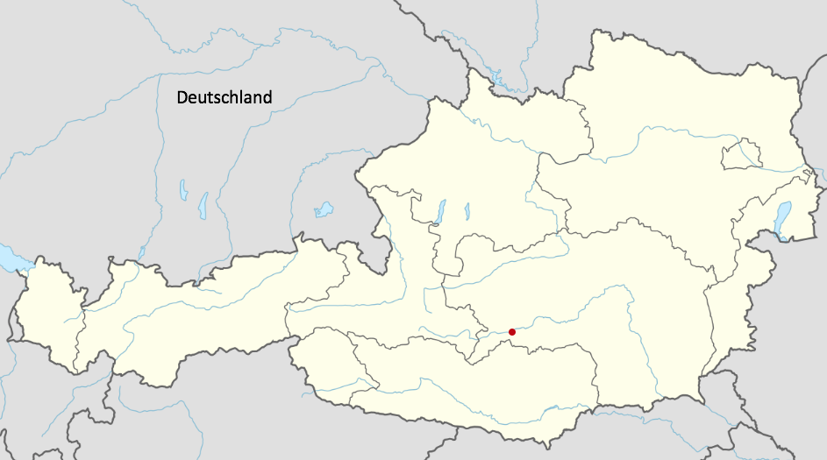
Murau, Austria

Slide 15
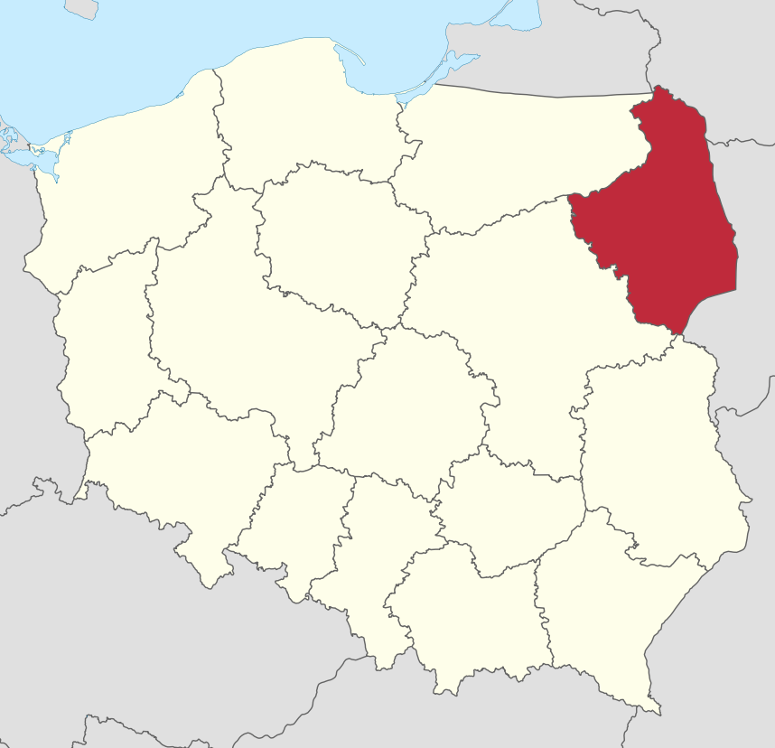
Podlasie, Poland

Slide 16
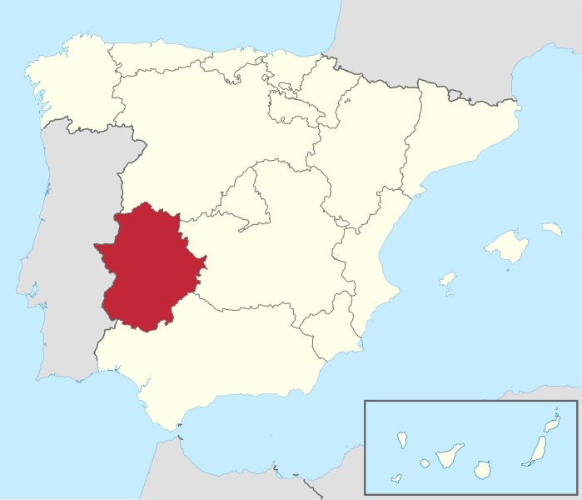
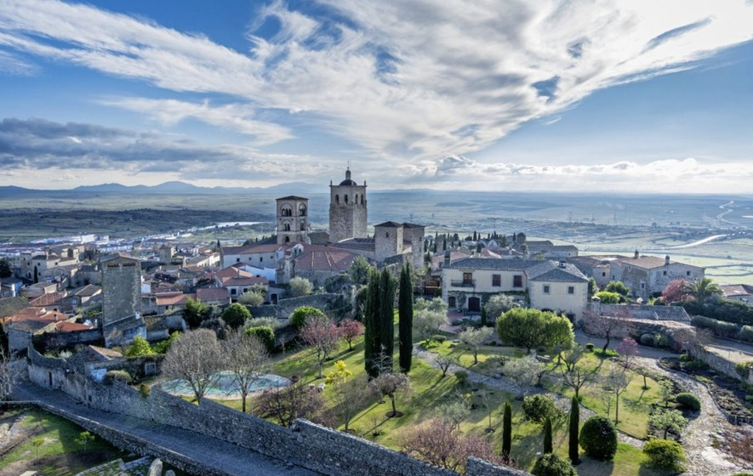
Extremadura, Spain

Slide 17
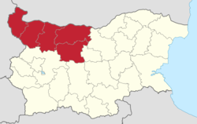
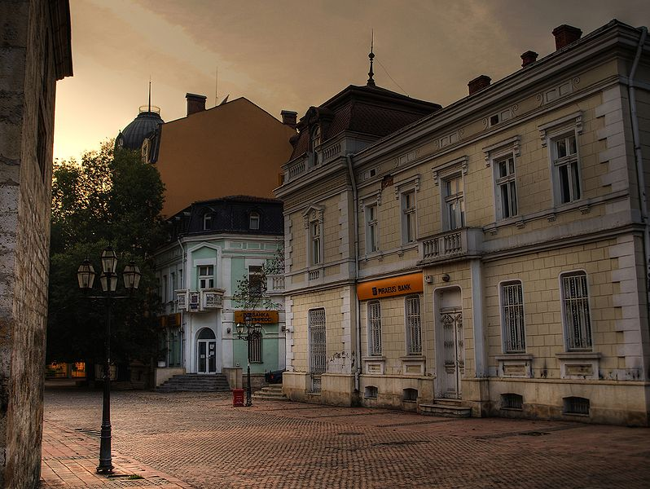
Severozapades, Bulgaria

Slide 18
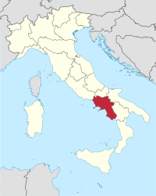
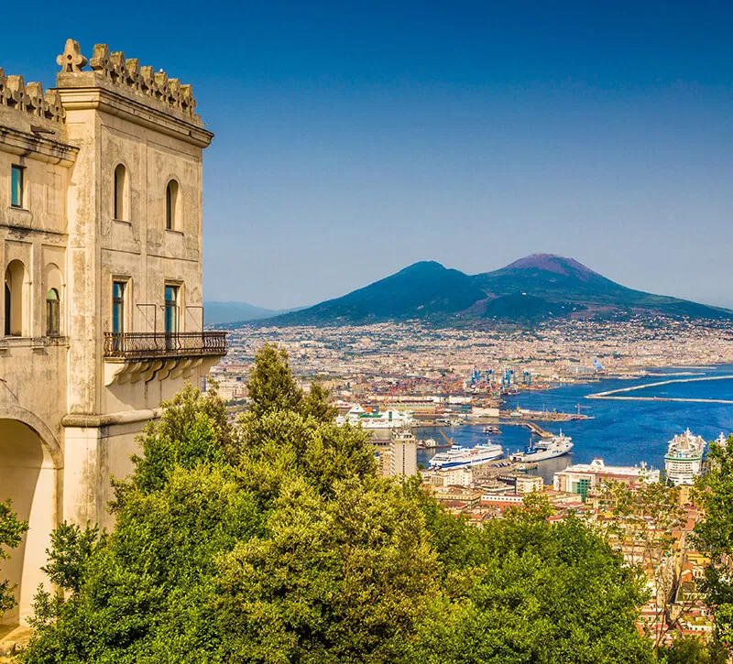
Campania, Italy

