Slide 1


City tour - The EU in our region

Slide 2
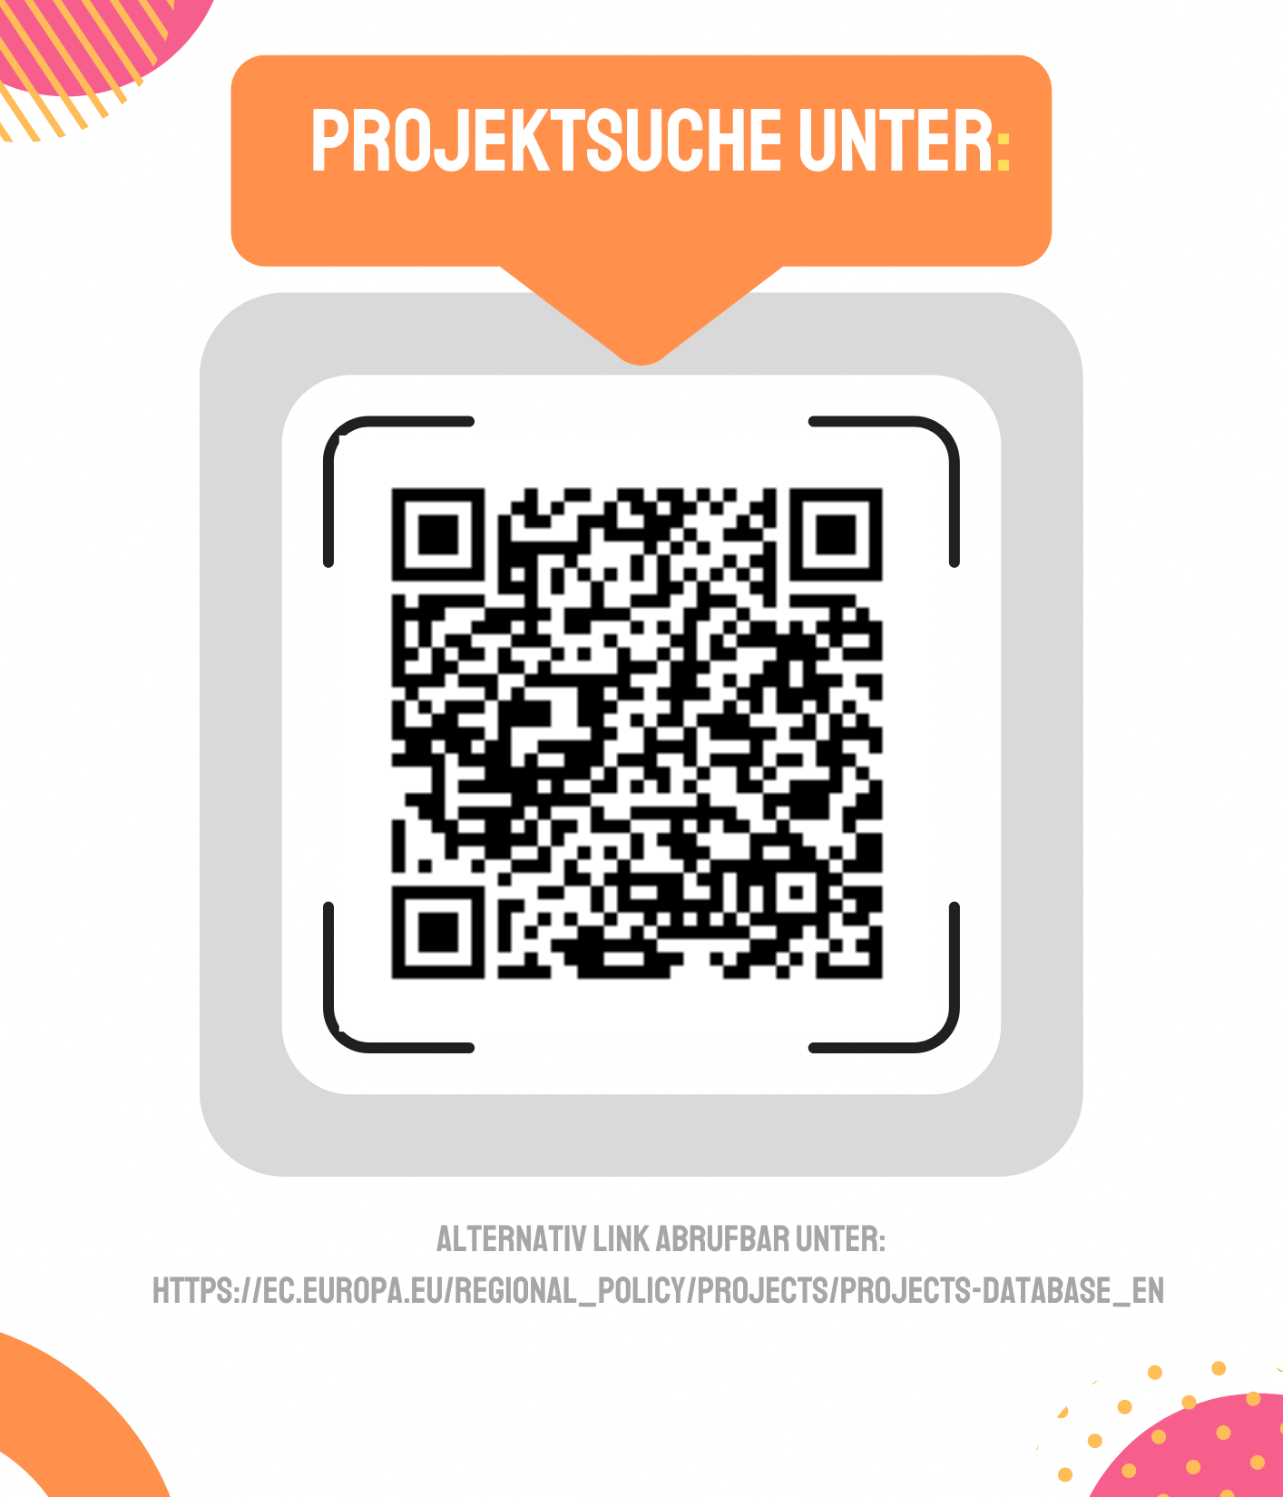
Search for projects at:
Research EU regional projects in your city / region!
LINK AVAILABLE AT:

Slide 3

Design a city tour with EU regional projects

Slide 4
Do you find any other European influences in your city or region?

