Slide 1


Still image of European Values

Slide 2
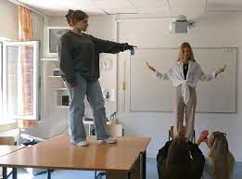
In your group: Think about how to represent the assigned value in a still image!
Attention:
Keep your term a secret!
You will present your still image to the others and they have to guess which value you are displaying.
Quelle: Schönstätter Marienschule

Slide 3

Presentation of your still image

Slide 4

Reflection
Why did you present the term in this way?
Why did the others recognize/not recognize the term?
- Was it easy/difficult?
Did you have other ideas in the group to represent the term?

