Slide 1


Ball Bearing

Slide 2
Goal of the exercise
You discuss a question about EU policy. One half of the class takes position A, the other position B. You discuss in several rounds in pairs and exchange as many arguments as possible in a short space of time.

Slide 3
Question for discussion: Is EU regional policy a suitable means of combating right-wing extremism in the member states?

Slide 4
Procedure
Divide the class into two groups. Each group takes a side in the discussion. A argues in favor, B against.
Read the text.
Try to find arguments for your position using the text, but also using anything else you can think of. (Important: You are not arguing for your own opinion).
Stand in two circles in front of each other. Group A stands on the inside, group B stands on the outside, so that each person faces a partner from the other group.
The facilitator stops the time. All pairs have 5 minutes to exchange as many arguments as possible.
The time is stopped. The outer circle moves one person to the left.
Steps 5 and 6 are repeated several times.

Slide 5

Read the text & collect arguments

Slide 6

Line up in two circles

Slide 7
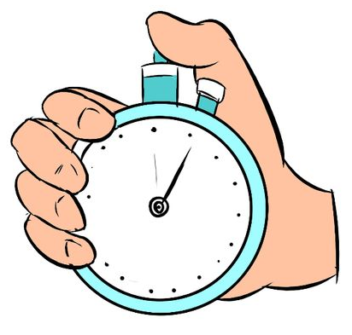
5 minutes to discuss

Slide 8

The outer circle moves one person to the left

Slide 9

Debriefing

