Slide 1


ONEpot of European values

Slide 2
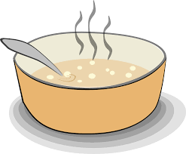
Excercise „ONEpot“

Slide 3
Deciding game
Argue according to your role and try to find compromises together with your group and create your "ONEpot"!

Slide 4
Deciding game
Insert, how many ingrediences each group can choose.

Slide 5
Debriefing
What values did you choose? Why?
What consequences follow from other values being absent? For whom?

